Slide 1
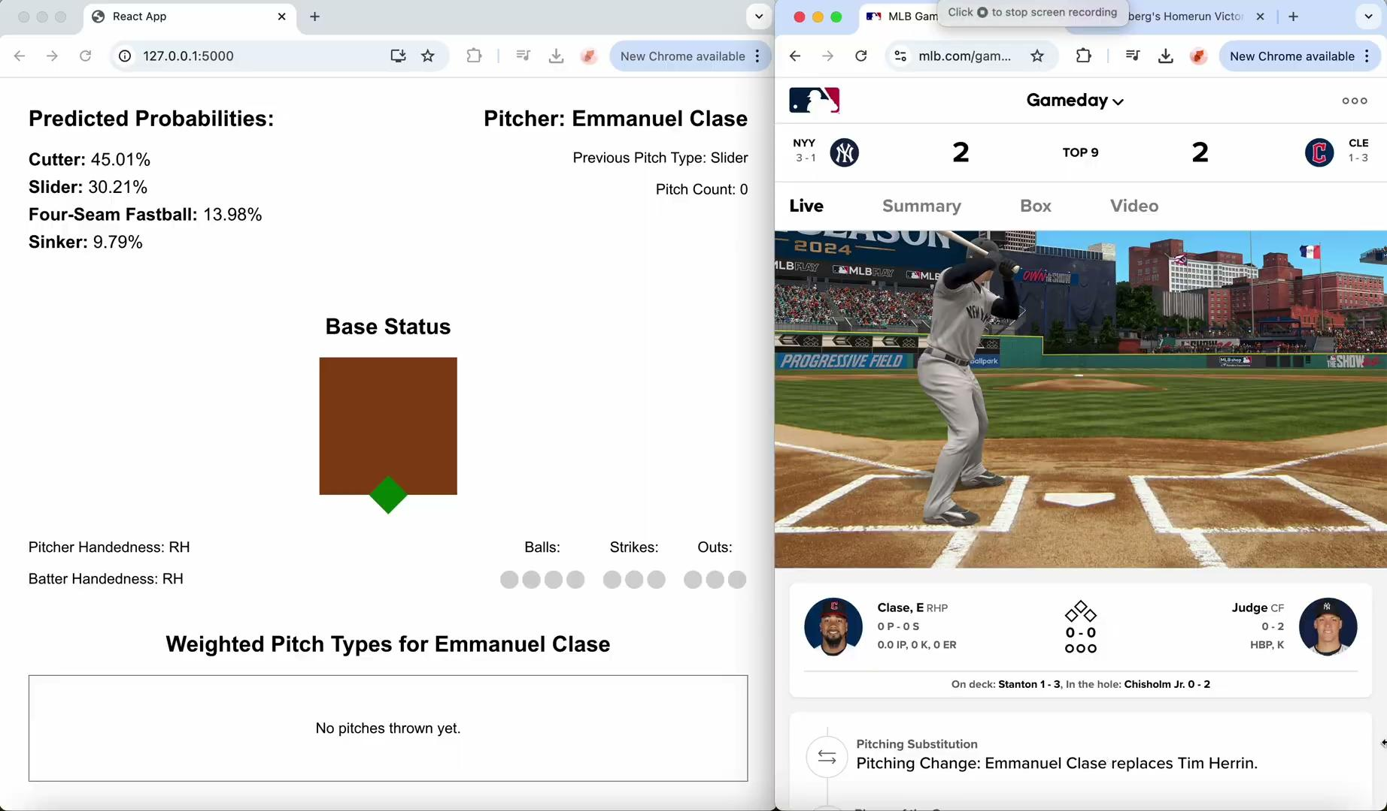
MLB Pitch Prediction

Slide 2
The Idea
Before a pitch is thrown, the batter and the coaching staff make a mental calculation to predict what the pitch type will be.
Can machine learning help them paint a more accurate picture?
We can train a model on millions of data points and deploy it in an application to provide the team with real-time predictions.

Slide 3

Data Sources
The pybaseball Python package allows us to pull data from statcast. For this project, I scraped data from the 2023 and 2024 regular seasons to use in model training, validation and testing.
statsapi.mlb.com/api provides us with real-time data to use as model inputs

Slide 4
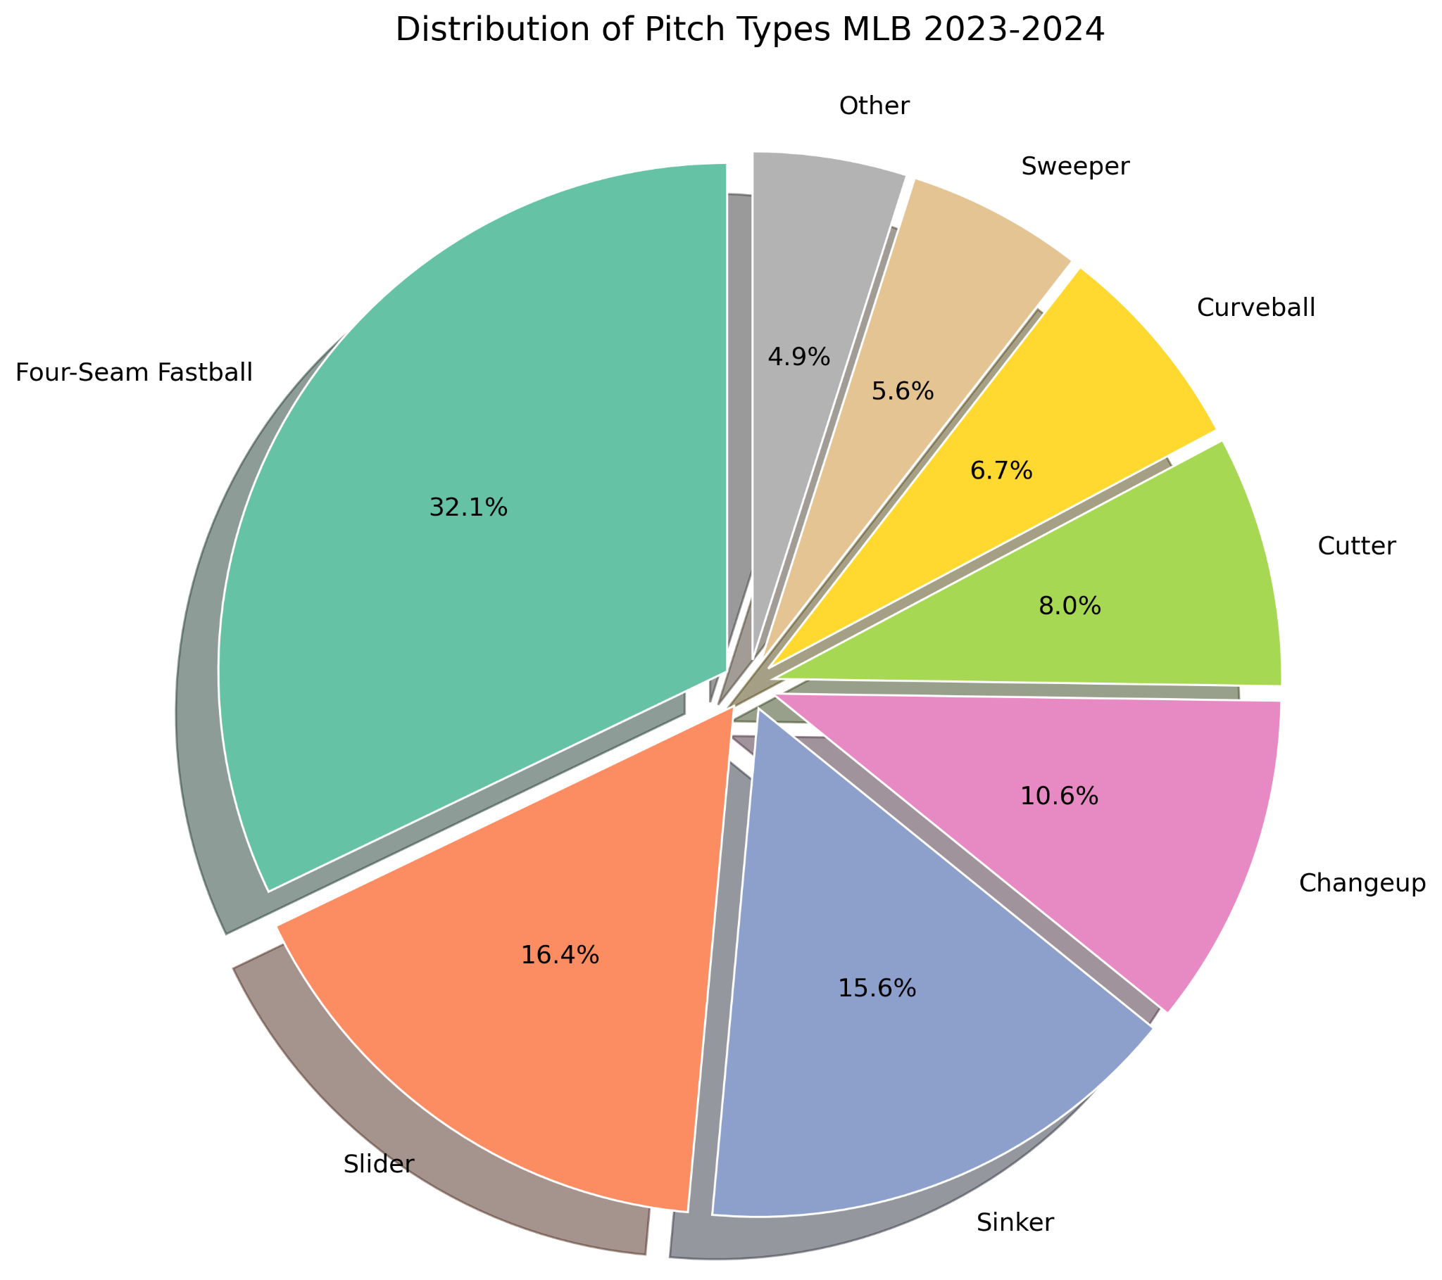
Pitch Type Distribution League Wide

Slide 5
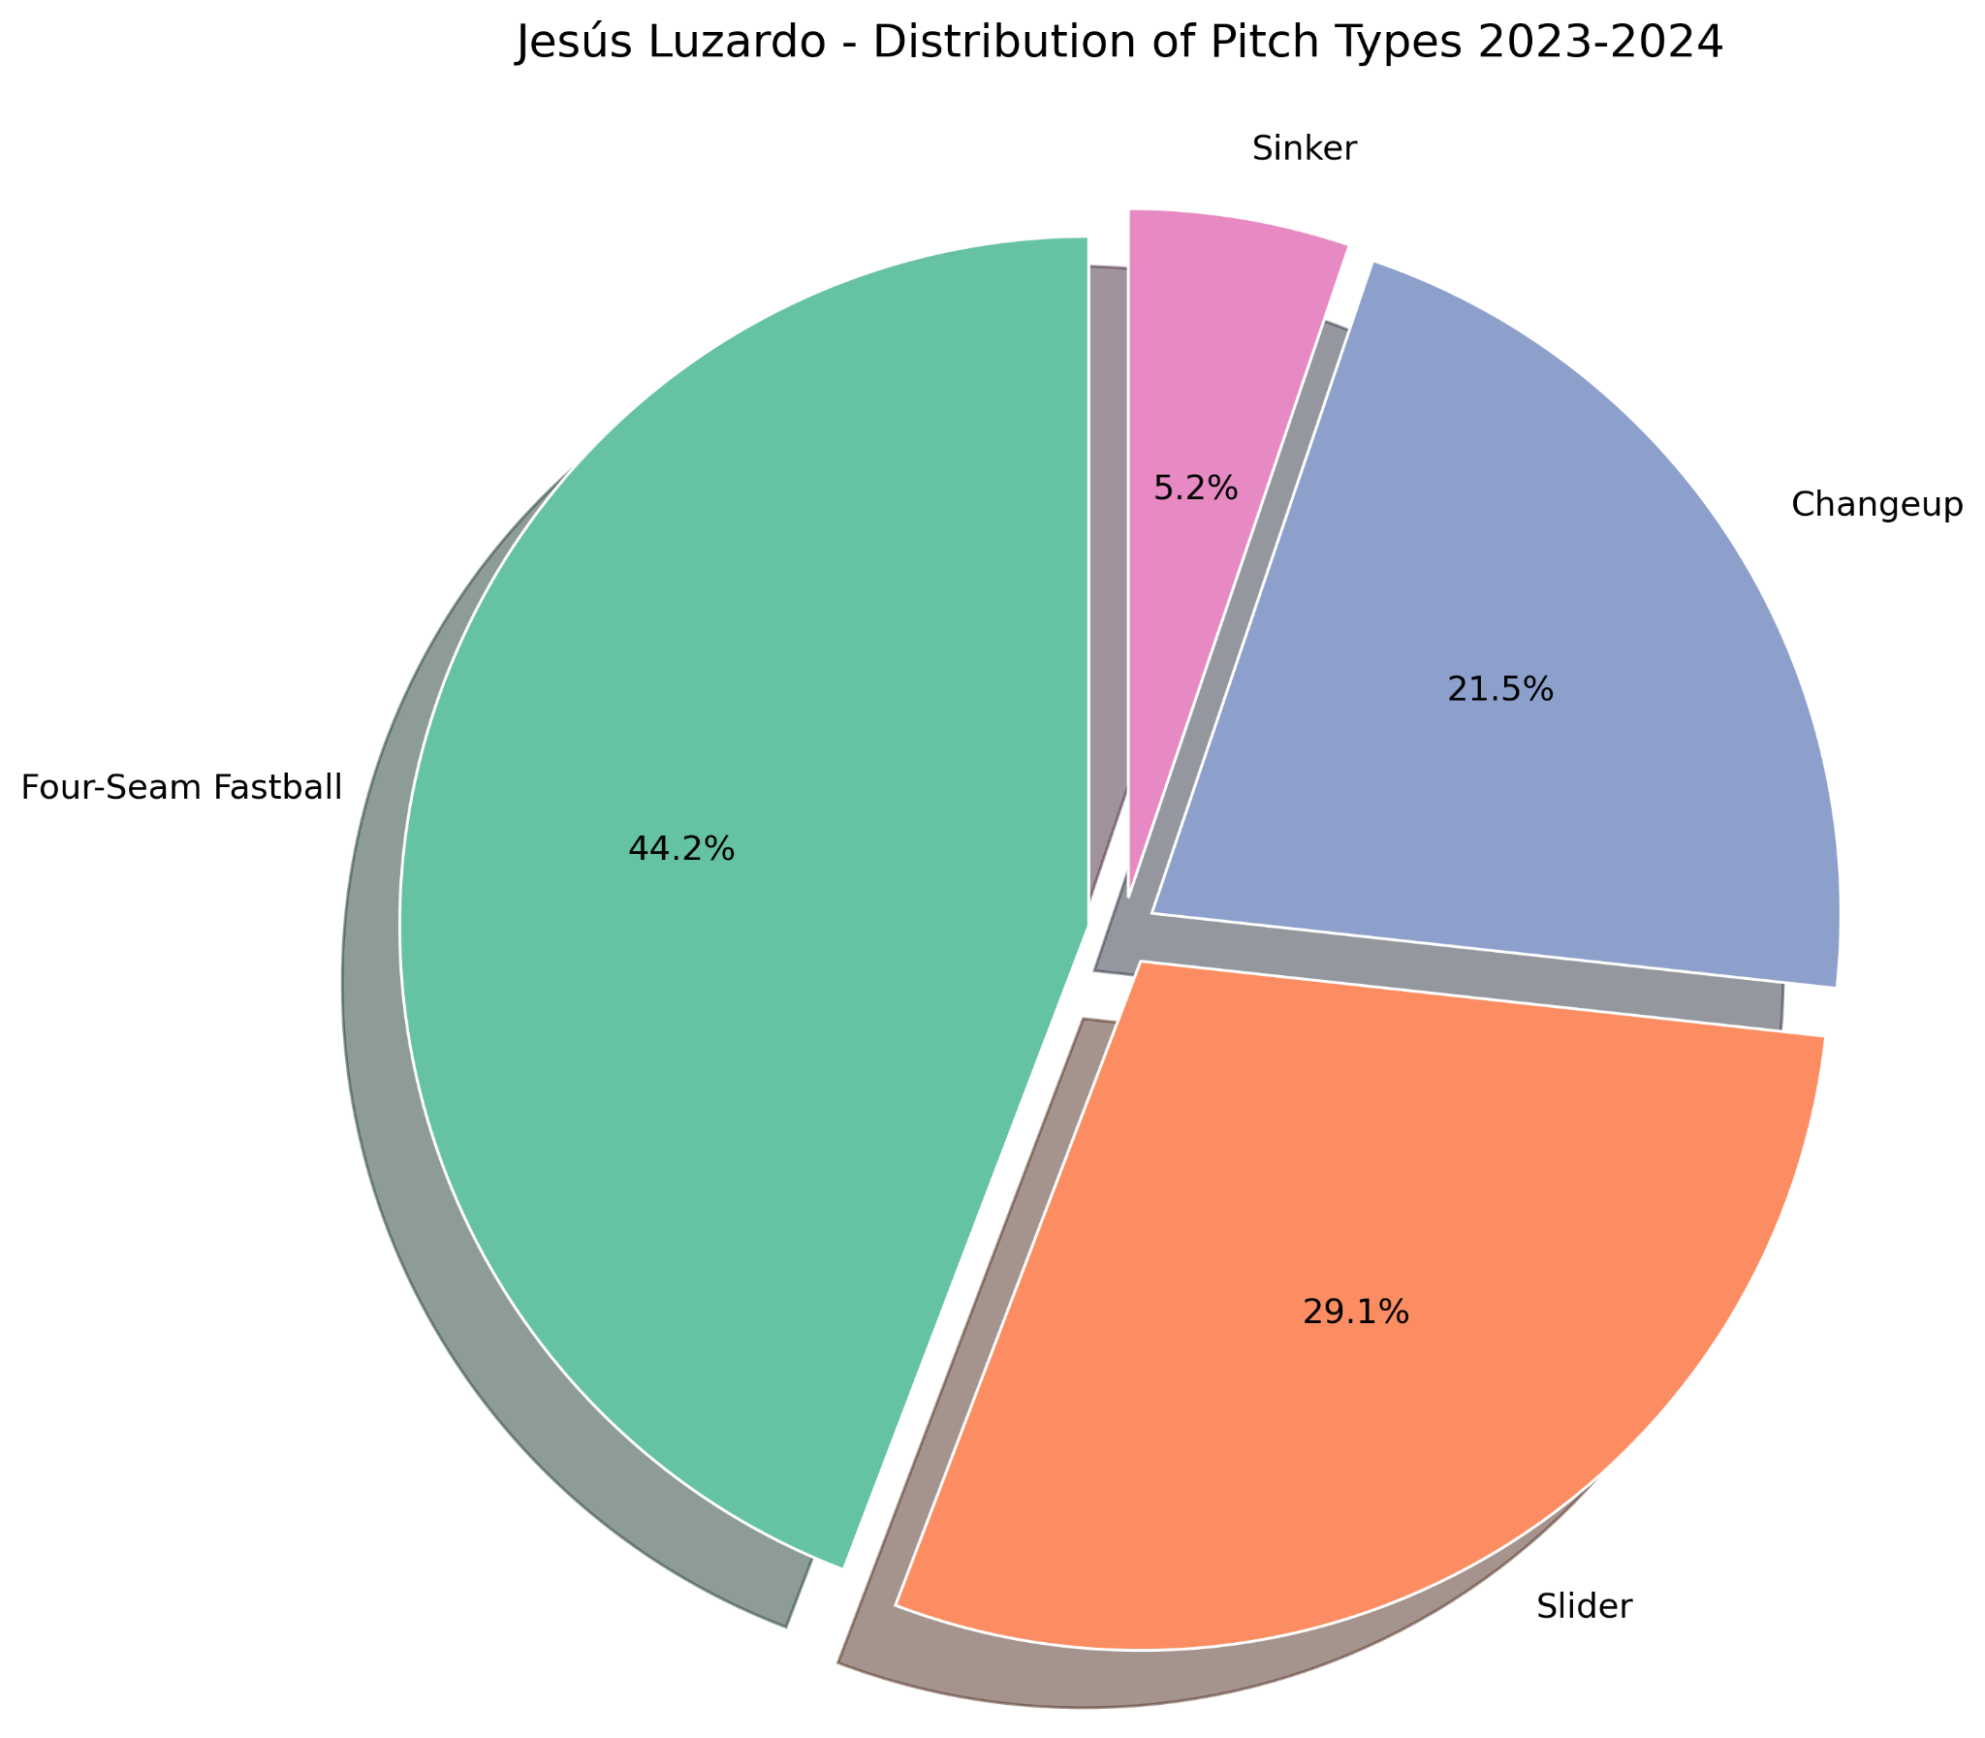
Pitch Type Distribution for an Individual Pitcher

Slide 6
Feature Selection
Previous Pitch Type: The pitcher's tendency to repeat certain pitches
Weighted Pitch Type: A running rate of all pitch types thrown by the pitcher in the current game, with more recent pitches having greater weight
Balls and strikes: The count can influence the pitcher's strategy
Outs: The number of outs can impact the pitcher's approach
Base runners: The presence of runners can affect pitch selection
Pitcher and batter handedness: Matchups can influence pitch selection
Pitch count: A pitcher's fatigue level can impact their pitch selection

Slide 7

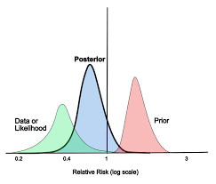

Modeling Approach
Tested a Gradient Boosting Classifier and a Neural Net
Used Cross Validation and Bayesian Optimization for Hyperparameter Tuning (# of boosting stages, learning rate, dropout rate, # of neurons…)
Evaluated primarily based on Multiclass Log Loss
Finally, I trained a separate GBC model for each individual pitcher, and combined it in a Bayesian fashion with the general model to improve performance

Slide 8
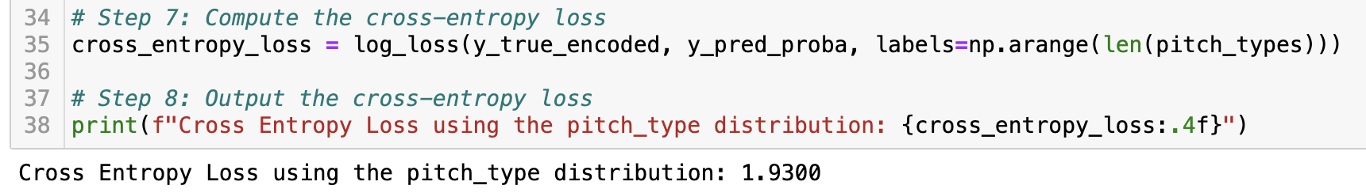
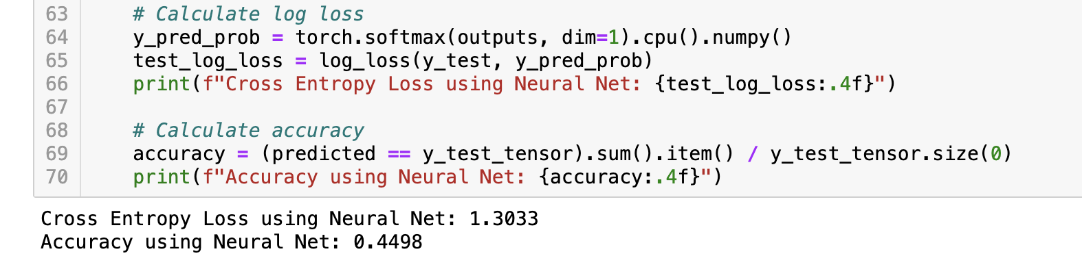
Results for General Model (Neural Net performed best)
Baseline (using the overall pitch type distribution):
Using the best Neural Network Model:

Slide 9
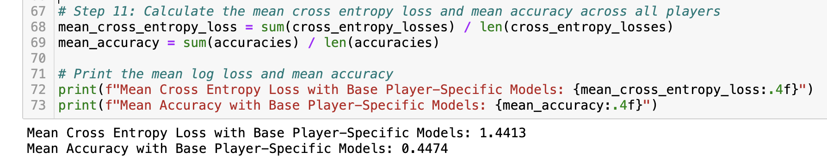
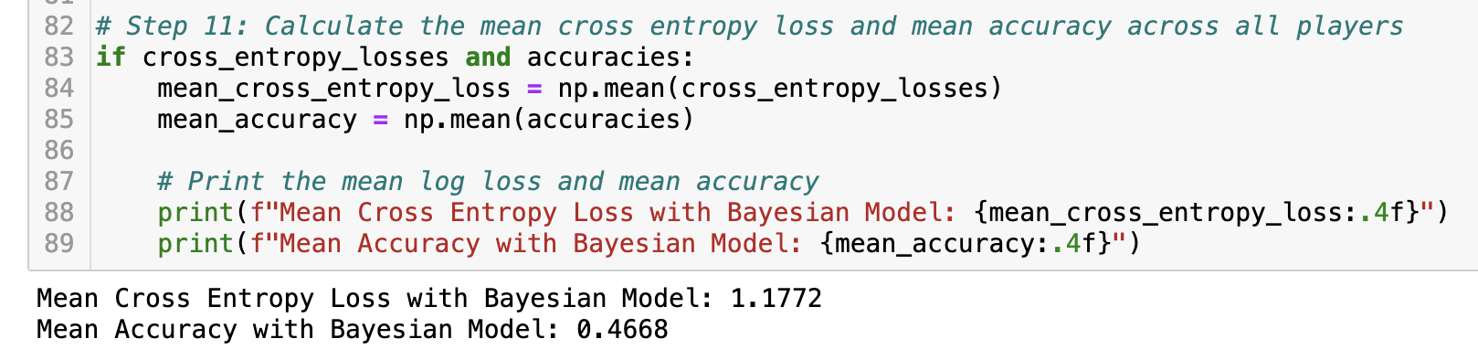
Results for Bayesian (Pitcher-Incorporated) Model
Baseline (using only player-specific GBC models with 50 estimators):
Using the Bayesian Approach:

Slide 10

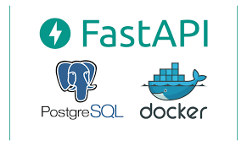

Deployment (Local)
GitHub Actions for scheduling (simple)
FastAPI for backend (high performance, offers asynchronicity if necessary)
PostgreSQL to store data (reliable, ensures concurrency)
Containerize each application with Docker and orchestrate with Docker Compose (ensures consistent environments across development and production while simplifying deployment and scaling)
JavaScript React for frontend

Slide 11


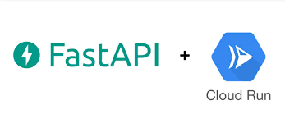
Deployment (Google Cloud Run)
Airflow for more complex scheduling
Google Cloud Storage and BigQuery to store data
GCP AI Platform to update models on a monthly basis
Google Cloud Monitoring and Google Cloud Logging to track system performance, manage resources and troubleshoot other issues that may arise

Slide 12
Challenges
The most difficult aspect of the project was setting up the logic for the data ingestion function. There were a wide variety of in-game scenarios that had to be accounted for in order to ensure that the correct model inputs would be obtained via the API before every pitch.
The MLB API has occasional latency issues; the app isn’t always able to update in time. Lowering the time between API calls helped to some extent.
The model doesn’t perform well for every pitcher. Yu Darvish is particularly challenging.

Slide 13
Further Applications
Use more data points during model training
Come up with new pitch sequence features
Get access to Fangraphs’ Leverage Index to use as a feature
Set up a scheduling pipeline to validate model performance on each pitcher the day before a game
Run experiments to see if different model types perform better for certain classes of pitchers (maybe start with cluster analysis?)
Watch the World Series!

Slide 14
Thank You!

